Slide 1
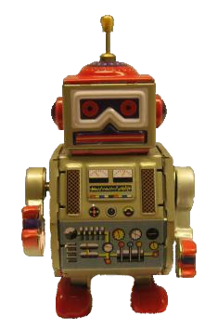
Robot Intellij Plugin
Adding Custom Language support to Intellij
Charles Capps

Slide 2
Table of Contents
Intro
Demos
Under the Hood – How does it work?

Slide 3
What is it, and where can I get it?

Slide 4
What is the Robot Plugin?
A Custom Language Plugin for Intellij
Adds support for a new language, the Robot Framework
Only compatible with Intellij 13 and above
Go to Preferences → Plugins → Browse Repositories
Search for “Robot plugin”
As of writing, newest version is 1.4.5

Slide 5
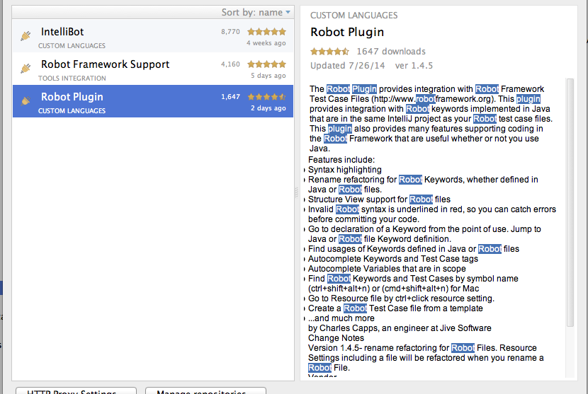
How to get it?

Slide 6

Why do such a crazy thing?

Slide 7
Why write a custom language plugin?
The Robot Framework is used for our UI Test automation
Back in February, there were no Intellij plugins for Robot
Even now, the Robot Plugin is the only one with Java support
Makes coding so much more efficient and less error-prone!
Search features help you find Test Cases and Keywords
Refactoring support saves time, and saves Jive money!

Slide 8
Demos of Features

Slide 9
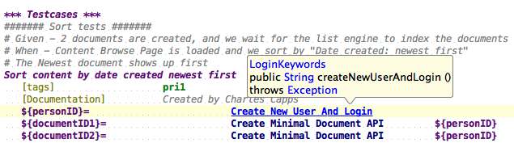
Resolving References to Declaration
Resolve Keyword to declaration in Java or Robot
Resolve Variable to local declaration or Variables table
Resolve Resource Files

Slide 10
Resolve Reference - Live demo time!

Slide 11
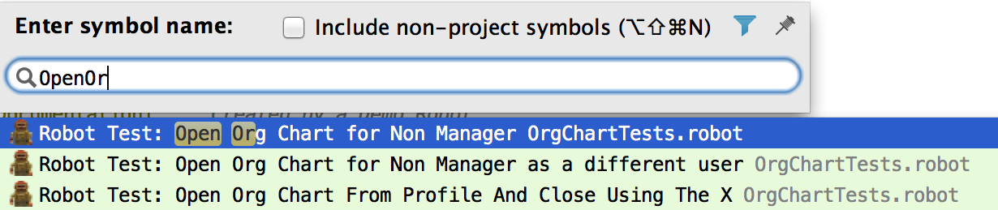
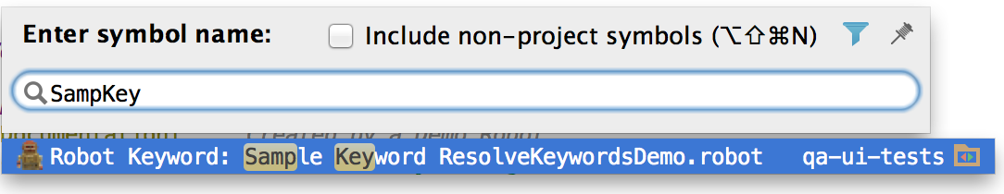
Searching for Test Cases and Keywords
Previously, you could only search by exact text occurrences
Now, can use Navigate → Symbol or ctrl+shift+alt+n

Slide 12
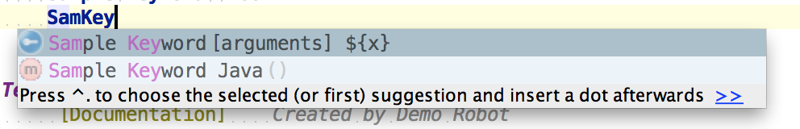
Autocomplete Keywords, Tags, and Variables
Start typing in a context where a Robot Keyword can be used
Results will pop-up automatically!
Made a conscious decision for Keyword autocomplete to use all keywords in the project, not just Keywords in scope (give explanation)
Variables – complete from variables in local scope, or included in Resource files.

Slide 13
Autocomplete - Live demo time!

Slide 14
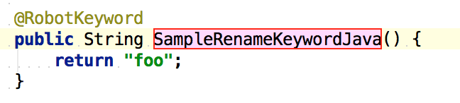
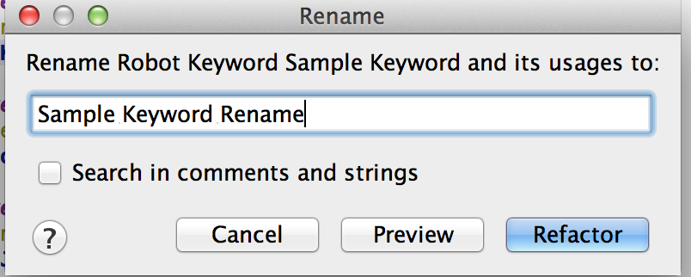
Rename Refactoring
Rename Java Keywords or Robot Keywords with Shift+F6
All usages will be renamed
Rename Variables – will smartly rename usages for the right scope
Rename Robot Files – Resource Settings will be renamed

Slide 15
Rename Refactoring - Live demo time!

Slide 16
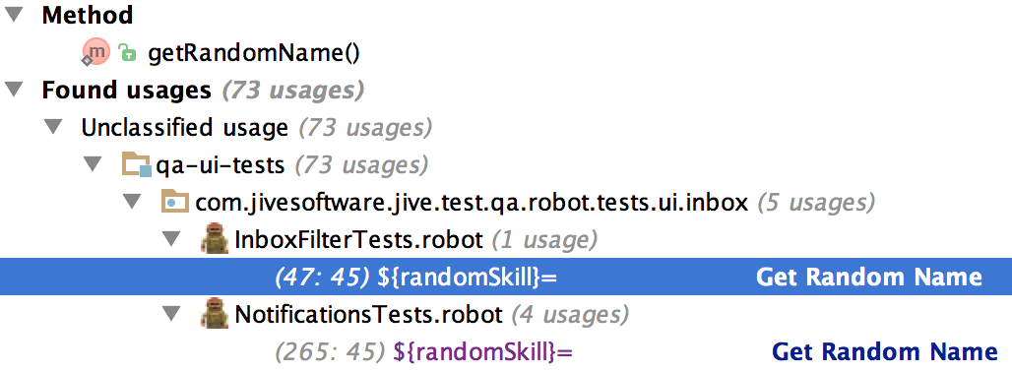
Find Usages of Keywords and Variables
To Find Usages: Right-click → Find Usages, or Ctrl+F7
Keep in mind, Robot is case-insensitive and doesn’t care about spaces and underscores.

Slide 17
Find Usages - Live demo time!

Slide 18
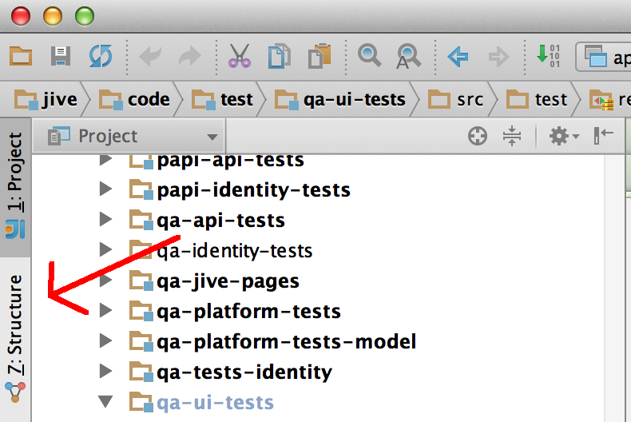
Structure View
See at a glance what Test Cases and Keywords are in a Robot File

Slide 19
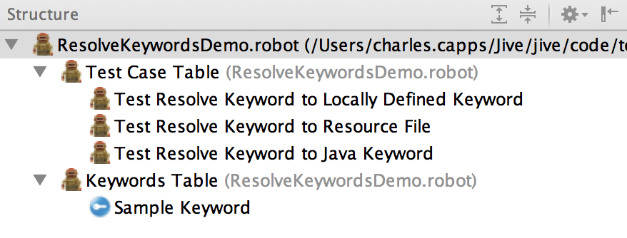
Structure View
Displays all Test Case Tables and Keywords Tables

Slide 20
Under the Hood – How does it work?

Slide 21
Step 1. Implement a Lexer

Slide 22
Step 1. Implement a Lexer
A lexer converts plain text into a sequence of Tokens.
Tokens determine Syntax Highlighting.
Intellij requires you to implement interface com.intellij.lexer.FlexLexer
The Grammar Kit Plugin comes in handy.
The Grammar Kit generates a Lexer from a JFlex file, .flex extension.

Slide 23
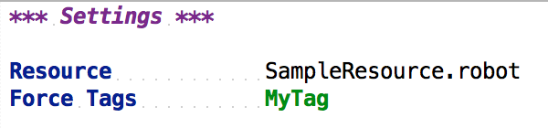
Example Lexing
=
[ SETTINGS_TABLE_HEADING, NEWLINE,
NEWLINE,
RESOURCE_SETTING, COLUMN_SEP, ROBOT_FILE, NEWLINE,
FORCE_TAGS_SETTING, COLUMN_SEP, TAG, NEWLINE ]

Slide 24
Step 2. Implement a Parser

Slide 25
Step 2. Implement a Parser.
Parser converts the Tokens into an Abstract Syntax Tree (AST)
AST is a tree representation of code.
Leaves of the tree are Tokens.
Branches of the tree are Program Structure Interface (PSI) elements
Intellij requires you to implement com.intellij.lang.PsiParser
Parser is generated from a BNF file (.bnf) using the Grammar Kit.

Slide 26
Example AST
=

Slide 27
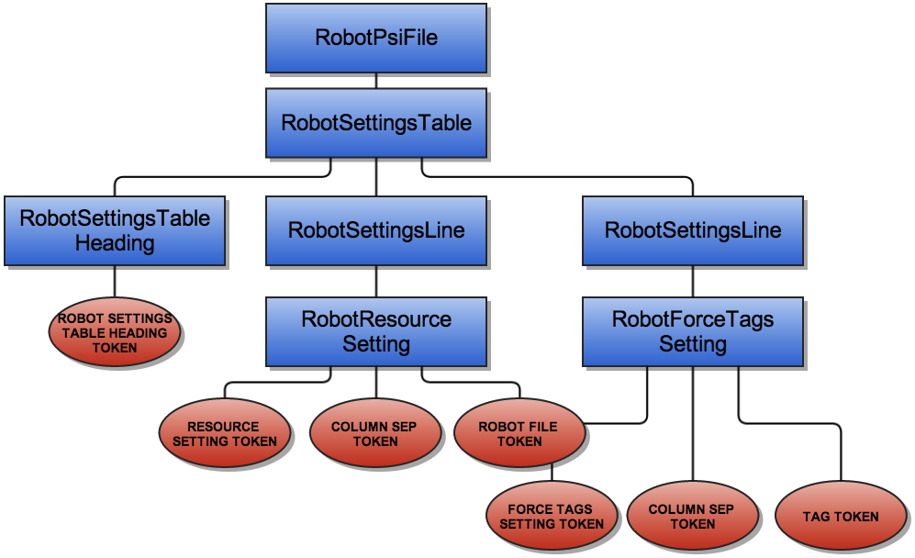
Example AST

Slide 28
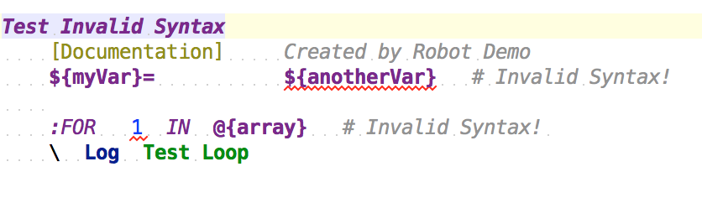
More facts about the Parser
Syntax Errors are highlighted in Red
Errors are when the Parser can’t create an AST from the code
There are tricks to make the parser resilient to errors
One syntax error shouldn’t cause the whole file to not be parsed

Slide 29
Step 3. Implement Extension Points

Slide 30
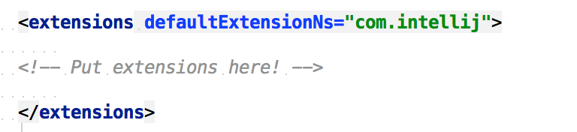
Step 3. Implement Extension Points
All Features of a Plugin are Extension Points in the plugin.xml
Extensions are inside the <extensions> tag:
The attribute defaultExtensionNs=“com.intellij” is the just the base package for the Intellij provided extension points

Slide 31
Extension Points
File Type Factory – registers the .robot extension
Syntax Highlighter – define how Tokens get syntax highlighting
Parser Definition – register your Parser
Reference Contributor – define how PSI elements resolve to declaration

Slide 32
…and a whole lot more!
Find Usages Provider
Custom Usages Searcher
Go to Symbol Contributor
Completion Contributor
Rename Psi Element Processor
…

Slide 33
Links
Github Page: https://github.com/jivesoftware/robot-intellij-plugin
Jetbrains page: http://plugins.jetbrains.com/plugin/7430?pr=idea
My blog: how-to-write-a-custom-language-plugin-for-intellij
Grammar Kit: https://github.com/JetBrains/Grammar-Kit
Jetbrains tutorial on Developing Custom Language Plugins

Slide 34

Questions?

